Slide 1
Graph Attention Network
Antonio Longa, Pytorch Geometric Tutorial 3: Graph attention Networks (GAT)
Veličković, Petar, et al. "Graph attention networks."
The Sixth International Conference on Learning Representations (ICLR) 2018, Vancouver, Canada
1/14/2025
Delin Meng
dylanmeng@chungbuk.ac.kr

Slide 2
Table of Contents
Introduction
Graph Attention Networks
Pros of Graph Attention Networks

Slide 3
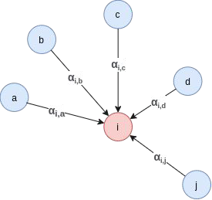
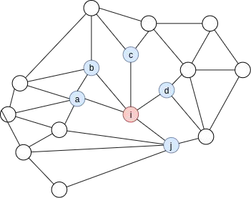
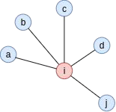
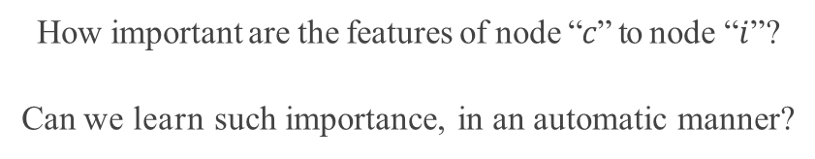
1. Introduction
GAT layer
How important are the features of node “$c$” to node “$i$”?
Can we learn such importance, in an automatic manner?
YES, with GAT

Slide 4
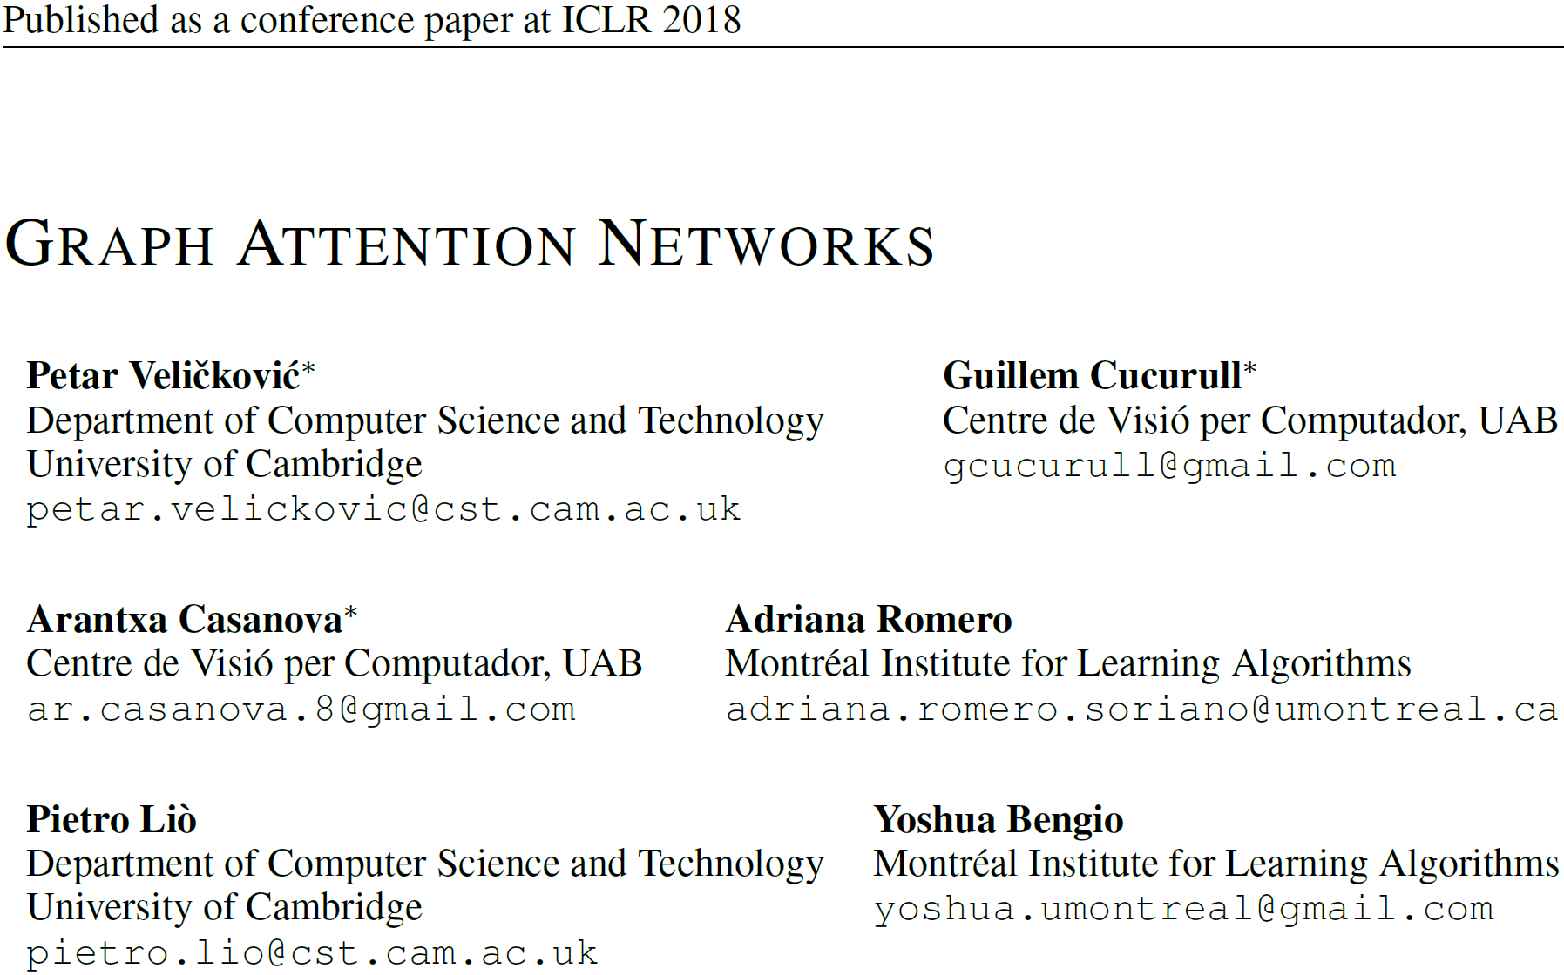

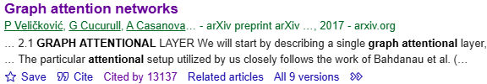
2. Graph Attention Networks
Petar Veličković
University of Cambridge, UK
Senior Research Scientist at Google DeepMind, London, UK

Slide 5

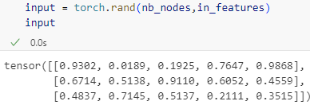
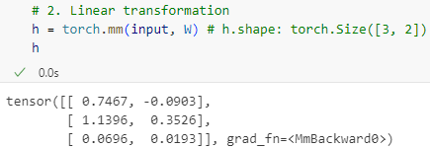
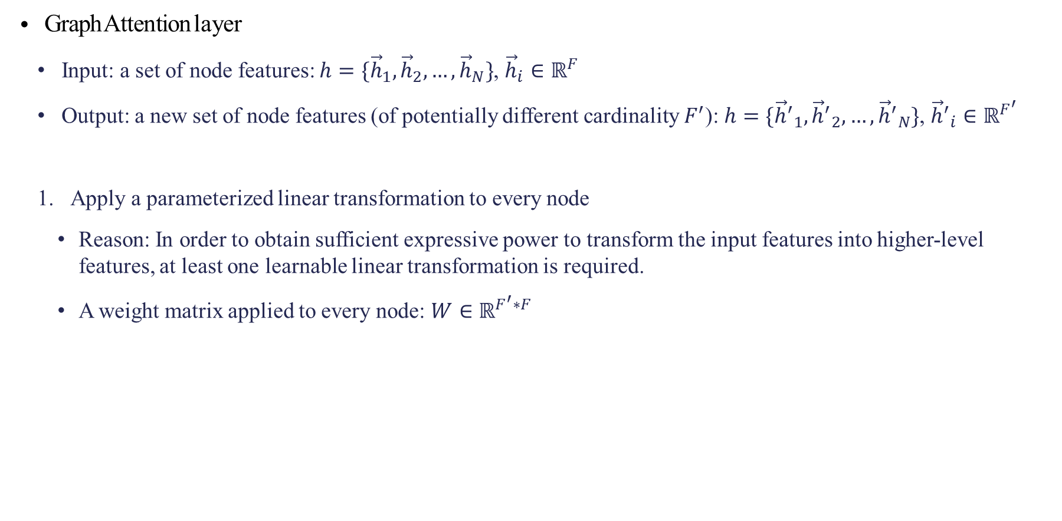
2. Graph Attention Networks
Graph Attention layer
Input: a set of node features: $h=\{{\vec{h}}_{1},{\vec{h}}_{2}, …,{\vec{h}}_{N}\}$, ${\vec{h}}_{i}∈ℝ^{F}$
Output: a new set of node features (of potentially different cardinality $F^{′}$): $h=\{{{\vec{h}}^{′}}_{1},{{\vec{h}}^{′}}_{2}, …,{{\vec{h}}^{′}}_{N}\}$, ${{\vec{h}}^{′}}_{i}∈ℝ^{F^{′}}$
Apply a parameterized linear transformation to every node
Reason: In order to obtain sufficient expressive power to transform the input features into higher-level features, at least one learnable linear transformation is required.
A weight matrix applied to every node: $W∈ℝ^{F^{′}∗F}$

Slide 6
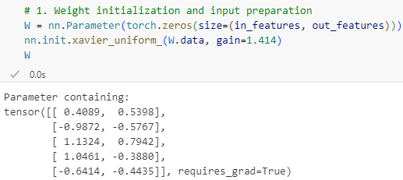
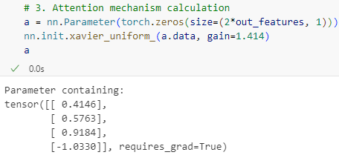

2. Graph Attention Networks
Graph Attention layer
Perform self-attention on the nodes—a shared attentional mechanism computes attention coefficients
$e_{ij}=a(W{\vec{h}}_{i},W{\vec{h}}_{j})$, $e_{ij}∈ℝ$
A single-layer feedforward neural network
Indicate the importance of node 𝑗’s features to node 𝑖.

Slide 7
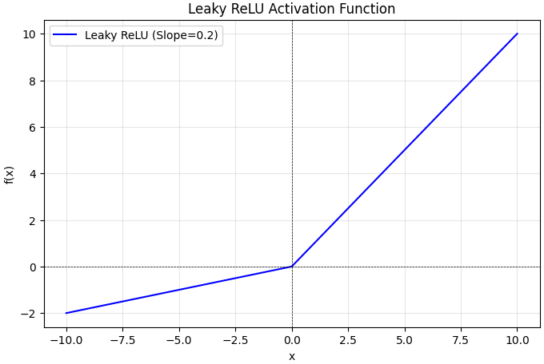
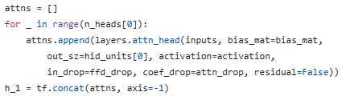

2. Graph Attention Networks
Graph Attention layer
To make coefficients easily comparable across different nodes, we normalize them across all choices of j using the softmax function
$a_{ij}={softmax}_{j}\left(e_{ij}\right)=\frac{exp⁡(e_{ij})}{\sum_{k∈N_{i}}{exp⁡(e_{ik})}}=\frac{exp⁡(LeakyReLU\left({\vec{a}}^{T}\left[W{\vec{h}}_{i}||W{\vec{h}}_{j}\right]\right))}{\sum_{k∈𝒩_{i}}{⁡exp(LeakyReLU\left({\vec{a}}^{T}\left[W{\vec{h}}_{i}||W{\vec{h}}_{k}\right]\right))}}$
$\vec{a}∈ℝ^{{2F}^{′}}$
$∙^{T}$: Transposition
$||$: Concatenation operation
Horizontal way!

Slide 8
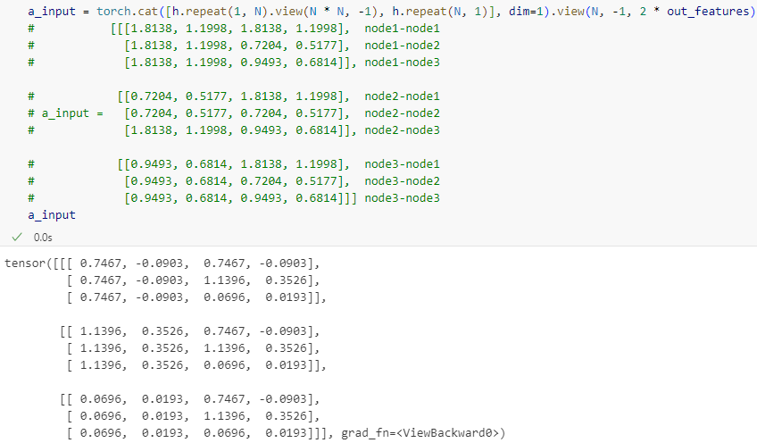
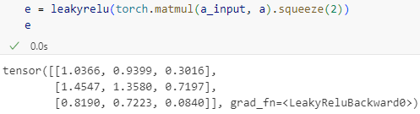
2. Graph Attention Networks
Graph Attention layer

Slide 9
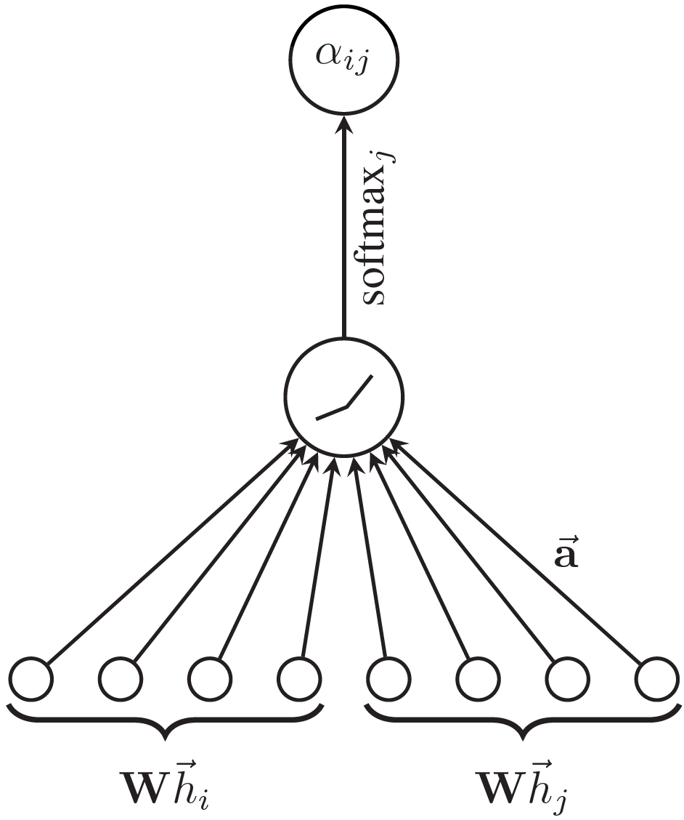



2. Graph Attention Networks
$${\vec{a}}^{T}\left[W{\vec{h}}_{i}||W{\vec{h}}_{j}\right]→\left(1∗{2F}^{′}\right)∙({2F}^{′}∗1)→(1∗1)$$
Graph Attention layer
Attention mechanism
$$W{\vec{h}}_{i}→\left(F^{′}∗F\right)∙(F∗1)→(F^{′}∗1)$$
$$W{\vec{h}}_{j}→\left(F^{′}∗F\right)∙(F∗1)→(F^{′}∗1)$$

Slide 10
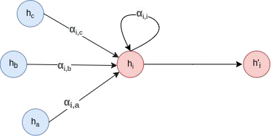

2. Graph Attention Networks
Graph Attention layer
Use $a_{ij}$
${\vec{h}}_{i}^{′}=σ(\sum_{jε𝒩_{i}}{a_{ij}W{\vec{h}}_{j})}$
The final output features for every node

Slide 11
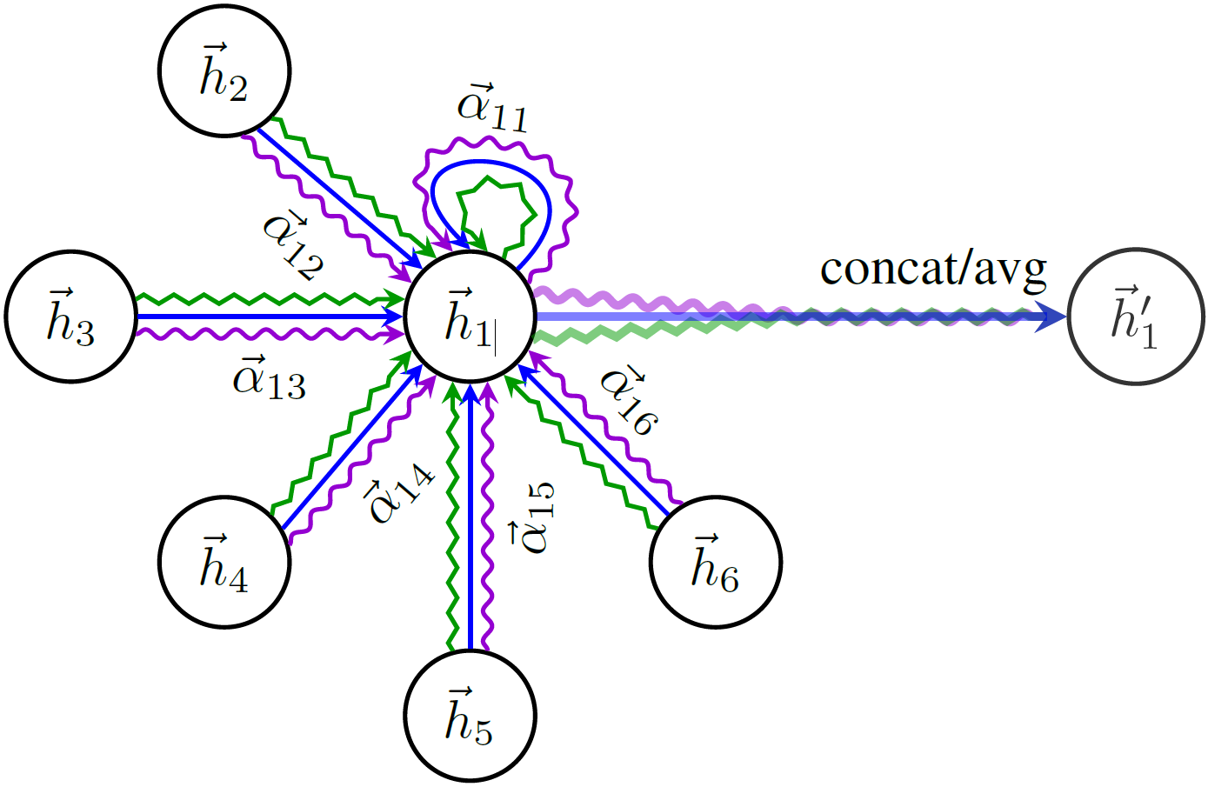

2. Graph Attention Networks
Graph Attention layer
Multi-head attention (similarly to Transformer)
${\vec{h}}_{i}^{′}={||}_{k=1}^{K}σ(\sum_{jε𝒩_{i}}{a_{ij}^{k}W{\vec{h}}_{j})}$
$||\text{: }\text{Concatenation} \text{operation}$
${\vec{h}}_{i}^{′}∈ℝ^{{KF}^{′}}$
Normalized attention coefficients computed by the k-th attention mechanism

Slide 12
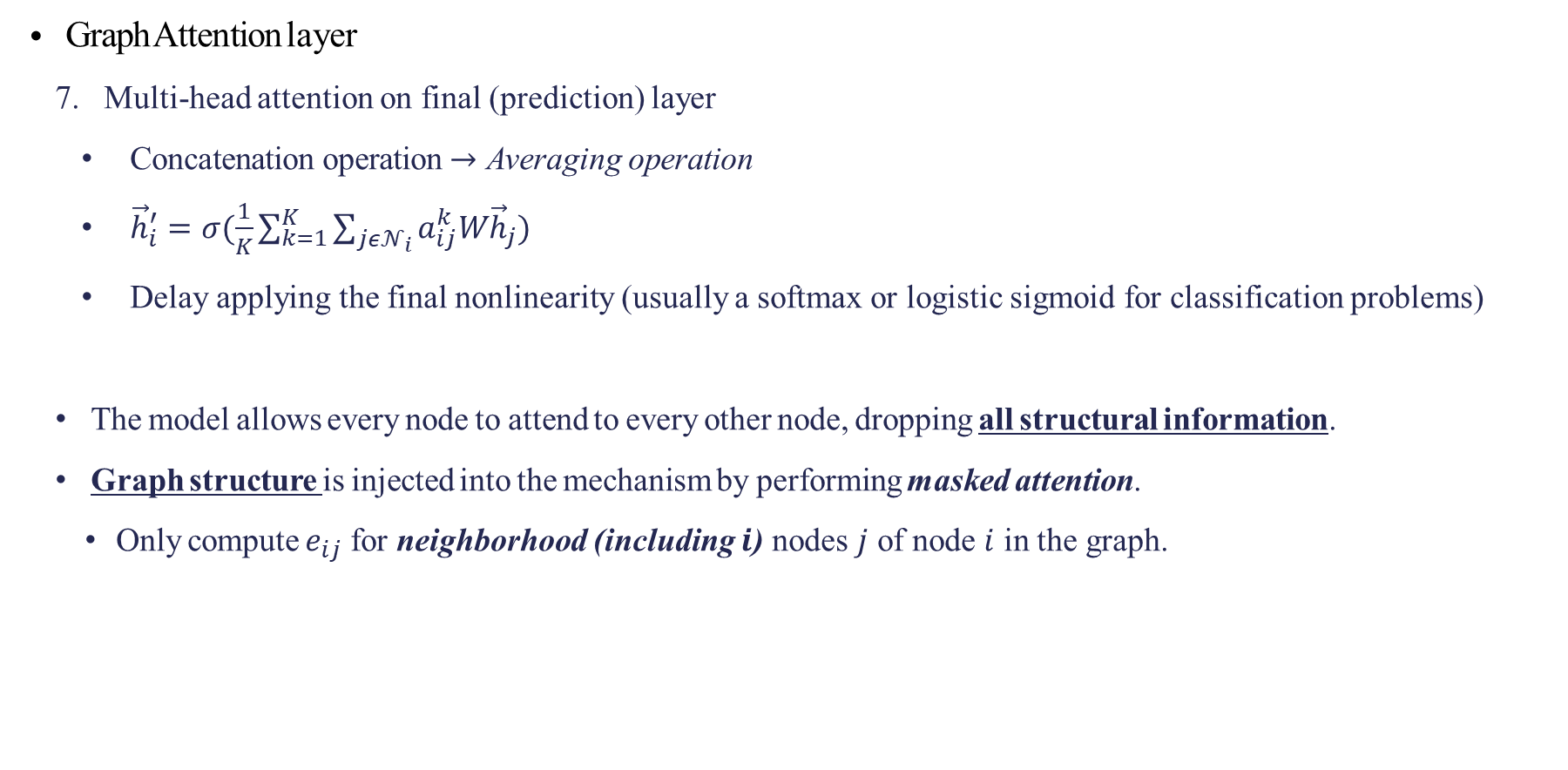
2. Graph Attention Networks
Graph Attention layer
Multi-head attention on final (prediction) layer
$\text{Concatenation} \text{operation}$ $→$ Averaging $\text{operation}$
${\vec{h}}_{i}^{′}=σ(\frac{1}{K}\sum_{k=1}^{K}{\sum_{jε𝒩_{i}}{a_{ij}^{k}W{\vec{h}}_{j})}}$
Delay applying the final nonlinearity (usually a softmax or logistic sigmoid for classification problems)
The model allows every node to attend to every other node, dropping all structural information.
Graph structure is injected into the mechanism by performing masked attention.
Only compute $e_{ij}$ for neighborhood (including $i$) nodes $j$ of node $i$ in the graph.

Slide 13
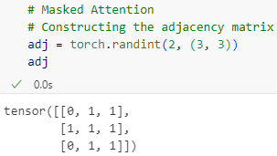
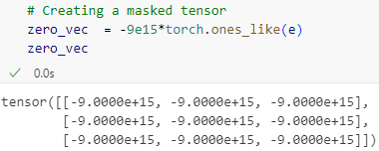
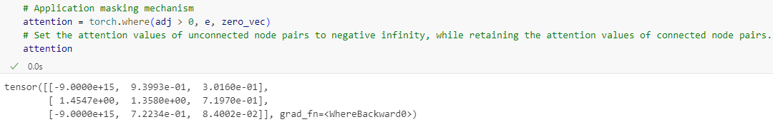
2. Graph Attention Networks
Graph Attention layer
8. Masked Attention

Slide 14
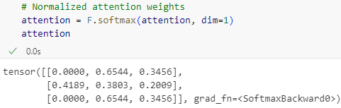
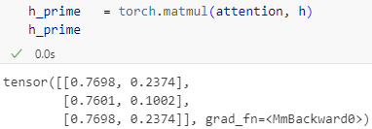
2. Graph Attention Networks
Graph Attention layer
8. Masked Attention

Slide 15
3. Pros of Graph Attention Networks
Computationally eﬃcient
Self-attention layers can be parallelized across edges
Output features can be parallelized across nodes
Allows to assign different importance to nodes of the same neighborhood
It is applied in a shared manner to all edges in the graph
Not required to have the entire graph
Works in both
Transductive learning
Inductive learning
Notes:
1.
Self-attention layers can be parallelized across edges, which reduces computational complexity. Output features can also be parallelized across nodes, further improving processing speed.
Output features can also be parallelized across nodes, further improving processing speed.
2. GATs use attention mechanisms to dynamically assign different weights to nodes within the same neighborhood, enabling more nuanced representation of local features.
3. The attention mechanism is applied in a shared manner across all edges in the graph. This eliminates the need to have access to the entire graph, making it more flexible.
4.
Transductive Learning: Useful for tasks involving existing nodes in the graph.
Inductive Learning: Capable of generalizing to unseen graphs or nodes, showcasing strong adaptability.

Slide 16


Slide 17

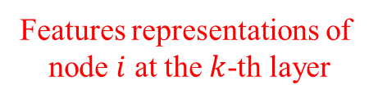
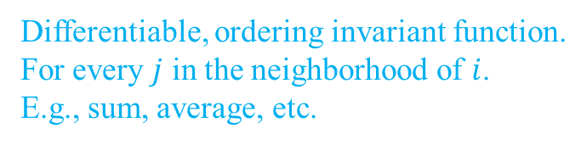
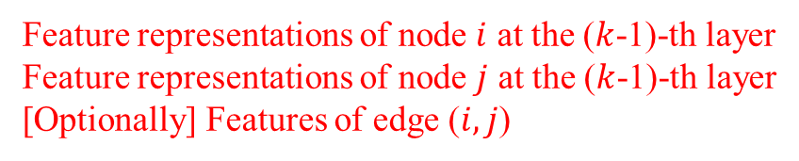
Appendix – Message passing implementation
$x_{i}^{(k)}=γ^{\left(k\right)}(x_{i}^{\left(k−1\right)},\sum_{j∈𝒩\left(i\right)}{φ^{\left(k\right)}(x_{i}^{\left(k−1\right)}},x_{j}^{\left(k−1\right)},e_{j,i}))$
Features representations of
node $i$ at the $k$-th layer
Differentiable function
Ex: MLP
Feature representations of node $i$ at the ($k$-1)-th layer
Feature representations of node $j$ at the ($k$-1)-th layer
[Optionally] Features of edge ($i,j$)
Differentiable, ordering invariant function.
For every $j$ in the neighborhood of $i$.
E.g., sum, average, etc.

